Slide 1
CSE 331
Automata and computability
Introduction to CFGs
Spring 2026

Slide 2
Today's learning goals Sipser Ch 1.4, 2.1
Define context-free grammars
Test if a specific string can be generated by a given context-free grammar
Test if a specific string can be generated by a given context-free grammar
Design a context-free grammar to generate a given language
Determine if a context-free grammar is ambiguous

Slide 3
The next model of computation
Idea: allow some memory of unbounded size
How?
  Generalization of regular expressions → Context-free grammars
  Generalization for DFA → Pushdown Automata

Slide 4
Birds' eye view
All languages over Σ
Context-free languages over Σ
Regular languages over Σ
Finite languages over Σ

Slide 5
Context-free grammar Sipser Def 2.2, page 102
(V, Σ, R, S)
Variables: finite set of (usually upper case) variables V
Terminals: finite set of alphabet symbols Σ
Rules/Productions: finite set of allowed transformations R
Start variable: origination of each derivation S

Slide 6
Context-free language Sipser p. 104
The language generated by a CFG (V, Σ, R, S) is
{ w in Σ* | Starting with the Start variable and applying one or more rules, can derive w on RHS}
If G = (V, Σ, R, S)
the language generated by G is denoted L(G).
Notation:
Terminology: sequence of rule applications is derivation

Slide 7
An example?
Consider the CFG
({S}, {0}, R, S)
where R is the following set of rules
S → 0S
S → 0
Is this a well-formed definition?
No: there's more than one rule
No: the same LHS gets sent to two different strings.
No: one of the string in the RHS has both variables and literals
Yes.
I don't know.

Slide 8
Context-free language Sipser p. 104
For CFG G = (V, Σ, R, S), L(G) = { w in Σ* | Starting with the Start variable and applying one or more rules, can derive w on RHS}.
What is the language of the CFG ({S}, {0}, R, S) with
R = {S → 0S, S → 0} ?
A. {0} B. {0, 0S} C. {0, 00, 000, …}
D. {ε, 0, 00, 000, …} E. I don't know.

Slide 9
Context-free language Sipser p. 104
What is the language of the CFG ({S}, {0,1}, R, S) with
R = the set of rules
S → 0S
S → 1S
S → ε
A. L(0*1*) B. L(0* U 1*) C. L( (0 U 1) *)
D. L ( (0*1*) )* E. I don't know.
S → 0S | 1S | ε

Slide 10
Designing a CFG
Can CFGs describe simple sets?
Building a CFG to describe the language
{ abba }
V = { S, T, V, W }
Σ = { a,b }
R = { S → aT T → bV V → bW W → a }
S

Slide 11
Designing a CFG
Can CFGs describe simple sets?
Building a CFG to describe the language
{ abba }
V =
Σ =
R =
S =
What's the set of terminals of this CFG?
{a,b}
V U S U Σ
{S, a, b}
{a,b, ε}
I don't know.

Slide 12
Designing a CFG
Can CFGs describe simple sets?
Building a CFG to describe the language
{ abba }
( { S, T, V, W } , { a,b } , { S → aT , T → bV , V → bW , W → a }, S )
OR
( { S } , { a,b } , { S → abba } , S )

Slide 13
Designing a CFG
We know this set is not regular!
Building a CFG to describe the language
{ a^{n}b^{n} | n ≥ 0 }

Slide 14
Designing a CFG
Building a CFG to describe the language
{ a^{n}b^{n} | n ≥ 0 }
One approach:
what is shortest string in the language?
how do we go from shorter strings to longer ones?

Slide 15
Designing a CFG
Building a CFG to describe the language
{ a^{n}b^{n} | n ≥ 0 }
V = { S }
Σ = { a,b }
R =
S
Which rules would complete this CFG?
S → ε | ab
S → ε | aS | Sb
S → ε | aSb
We need another variable other than S.
I don't know.

Slide 16
Designing a CFG
Also not a regular set
Building a CFG to describe the language
{ 0^{n}1^{m}2^{n} | n,m ≥ 0 }
Hint: work from the outside in.

Slide 17
Designing a CFG
Also not a regular set
Building a CFG to describe the language
{ 0^{n}1^{m}2^{n} | n,m ≥ 0 }
Hint: work from the outside in.
V = { S, T }
Σ = { 0,1,2 }
R = { S → 0S2 | T | ε , T → 1T | ε }
S

Slide 18
Is every regular language a CFL?
Approach 1: start with an arbitrary DFA M, build a CFG that generates L(M).
Approach 2: build CFGs for {a}, {ε}, {}; then show that the class of CFL is closed under the regular operations (union, concatenation, Kleene star).

Slide 19
Approach 1 (Converting regular languages into CFL)
Claim: Given any DFA M, there is a CFG whose language is L(M).
Construction:
Trace computation using variables to denote state
Given M = (Q,Σ,δ,q₀,F) a DFA, define the CFG
V = { S_{i} | q_{i} is in Q }
Σ
R = { S_{i} → aS_{j} | δ(q_{i},a) = q_{j} } U { S_{i} → ε | q_{i} is in F}
S = S₀
Then prove correctness…

Slide 20
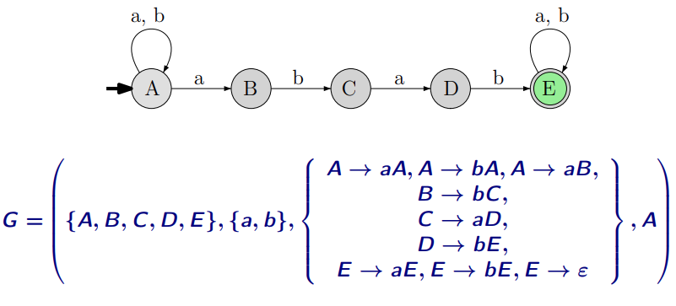
Approach 1 (Converting regular languages into CFL)

Slide 21
Approach 1 (Converting regular languages into CFL)
Building a CFG to describe the language
{w | w start and end with different symbols}
Hint: write the regular expression first then convert the regular expression to CFG
Regular expression: a(a+b)*b + b(a+b)*a

Slide 22
Approach 1 (Converting regular languages into CFL)
Building a CFG to describe the language
{w | w start and end with different symbols}
V = { S, A, B }
Σ = { a,b }
R = { S → aPb | bPa , P → aP | bP | ε }
S

Slide 23
Approach 2
Build CFGs for {a}, {ε}, {}; then show that the class of CFL is closed under the regular operations (union, concatenation, Kleene star).

Slide 24
Approach 2
If G₁ = (V₁, Σ, R₁, S₁) and G₂ = (V₂, Σ, R₂, S₂) are CFGs
and G₁ describes L₁, G₂ describes L_{2,} how can we combine the grammars so we describe L₁ U L₂ ?
V = V₁ U V₂ U {S}
Σ
R = R₁ U R₂ U {S → S₁ | S₂ }
S

Slide 25
Designing a CFG
Building a CFG to describe the language
{ ww^{R} | w in Σ*}
V = { S }
Σ = { a,b }
R =
S
Which rules would complete this CFG?
S → ε | ab
S → ε | aSa | bSb
S → ε | aSb
We need another variable other than S.
I don't know.

Slide 26
Designing a CFG – challenge!
Building a CFG to describe the language
{ ww | w in Σ*}
V = { S }
Σ = { a,b }
R =
S
Which rules would complete this CFG?
S → ε | aS | bS | SS
S → ε | aSb | bSa
S → ε | aSa | bSb
None of these work
I don't know.

Slide 27
Designing a CFG – challenge!
Building a CFG to describe the language
{ ww | w in Σ*}
V = { S }
Σ = { a,b }
R = ?
S
This language is not context free!
This can be proved using a
“pumping lemma” for context free languages

Slide 28
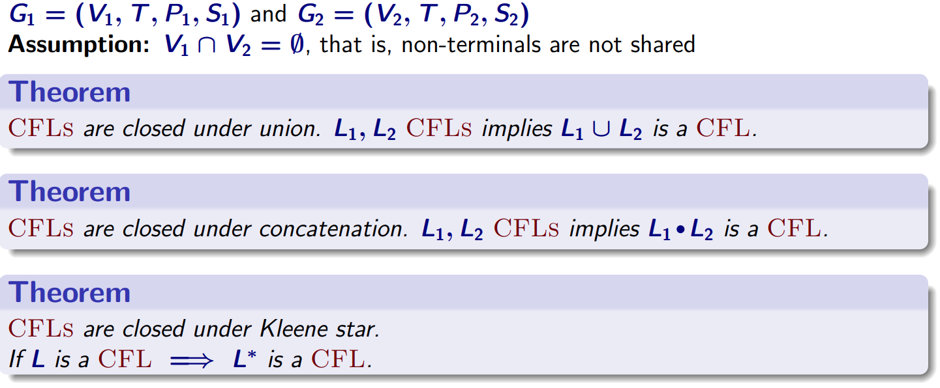
Closure properties of CFLs

Slide 29
More bad news: CFL not closed under intersection
CFLs are not close under complementation as well.

Slide 30
CFGs in the wild
V = {E}, Σ = {1,+,x,(,)}, R = { E → E+E | ExE | (E) | 1 }, S=E
Describing well-formed arithmetic expressions
Which of the followings strings is generated by this CFG?
E
11
1+1x1
ε
I don't know.

Slide 31
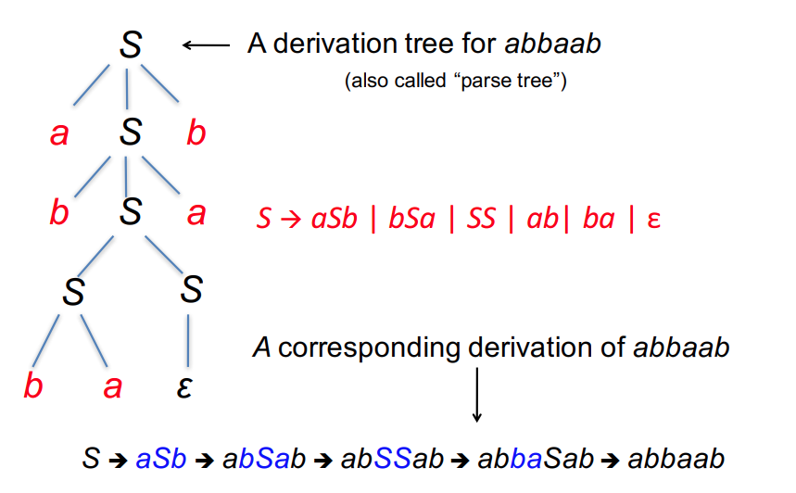
Derivations and parsing

Slide 32
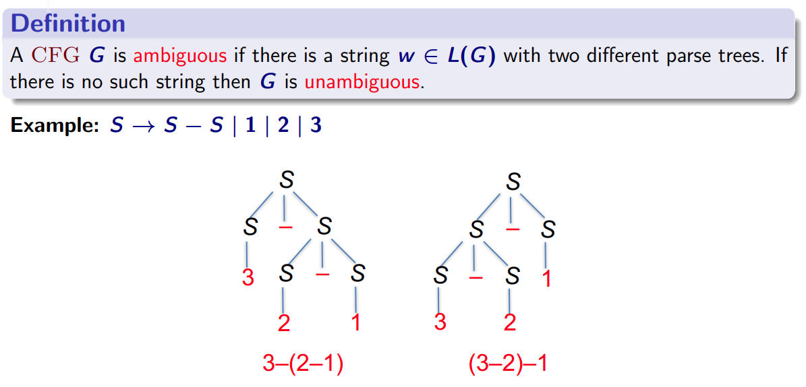
Ambiguity in CFLs

Slide 33
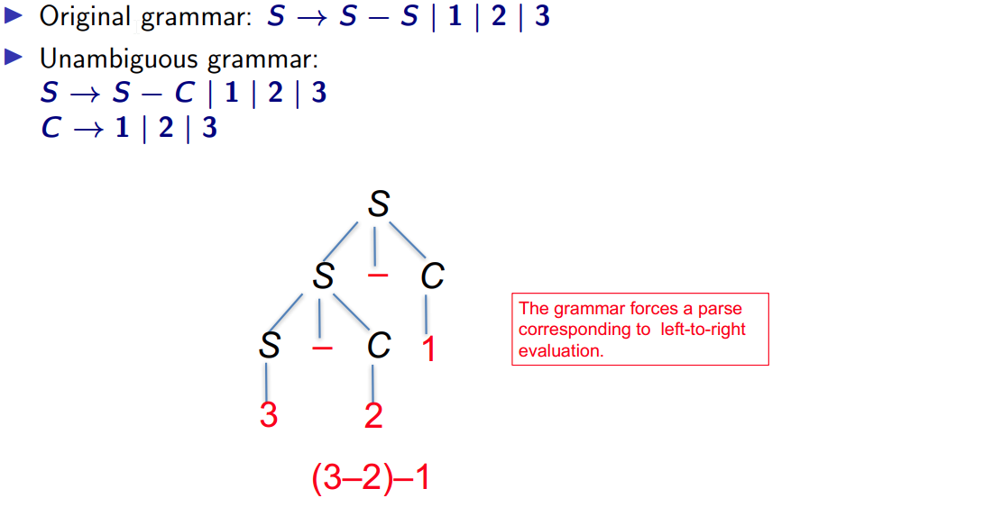
Ambiguity in CFLs

Slide 34
Derivations and parsing
E → E+E | ExE | (E) | 1
Lots of derivations for 1+1x1

Slide 35
Derivations and parsing
E → E+E | ExE | (E) | 1
Lots of derivations for 1+1x1

Slide 36
Derivations and parsing
E → E+E | ExE | (E) | 1
Lots of derivations for 1+1x1
A string is ambiguously derived in a CFG if it has more than one leftmost derivation i.e. more than one parsing tree

Slide 37
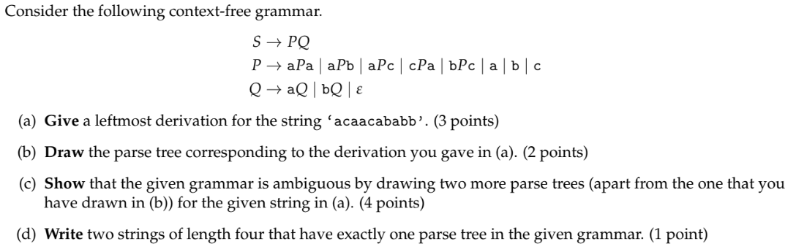
Derivation, Parse Tree and Ambiguity

Slide 38

Recap: Context-free languages
Context-free grammar
One-step derivation
Derivation
Language generated by grammar

